Slide 1




This presentation has live captioning
NHA-254
CLOUD-NATIVE DEVOPS PIPELINE FOR DEPLOYING AND MONITORING A FASTAPI APPLICATION
DEPI Final Project
PRESENTED BY:
Omnia Nabil Gharib

Slide 2


03 | Overview
04 | Goals
05 | Architecture
06 | Terraform Infrastructure
07 | Ansible Automation
08 | Kubernetes Cluster
09 | Monitoring
11 | To-Do App
Stages

Slide 3

01
This project uses AWS Cloud along with Terraform, Ansible, and Kubernetes to deploy a FastAPI application.
03/10
02
It also integrates Prometheus, Grafana, and Alertmanager to provide full monitoring and alerting.
Overview
Introduce the project.
03
The environment supports stable performance, clear monitoring, and efficient application deployment.
http://44.223.80.194:30080/

Slide 4


04/10
Objectives and Goals
Clarify the project's main overall objectives and goals.
Goal # 1
Goal # 2
Goal # 3
Automate infrastructure and Kubernetes deployment on AWS using Terraform and Ansible.
Enable complete visibility using monitoring dashboards.
Deploy a FastAPI application on Kubernetes

Slide 5
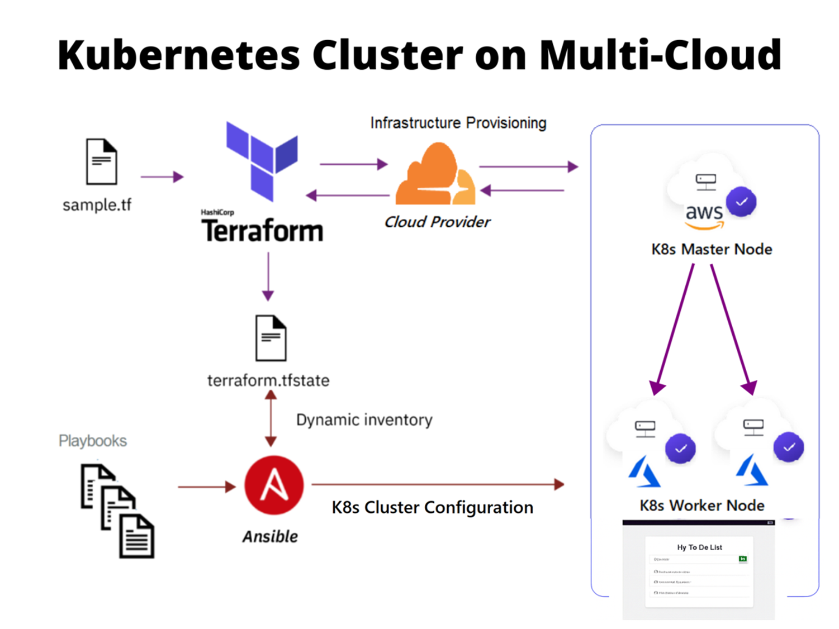
Architecture
05/10

Slide 6
Terraform Infrastructure
06/10
used to create the following on AWS:
AWS VPC
Security Groups
Internet Gateway
EC2 Master Node
Subnets
EC2 Worker Nodes
Route tables
SSH Key Pair

Slide 7

Ansible
07/10
Install the following on EC2s:
Kubernetes, Docker and Containrd on Master and Worker nodes
Join worker nodes with the cluster
Monirotring tools:
Prometheus
Node Exporter
Grafana
Collects and stores system metrics.
PULL base model
Monitors system and hardware resources.
Visualizes metrics through interactive dashboards.

Slide 8
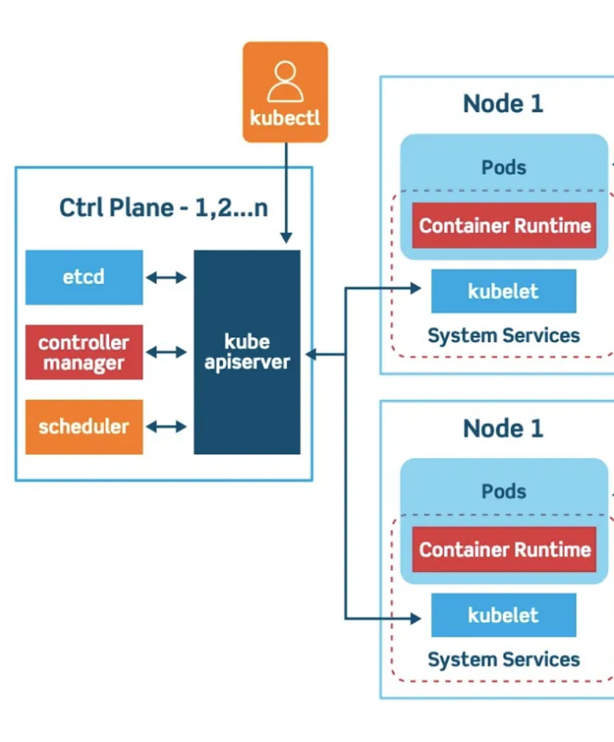
08/10
Kubernetes Cluster
The project uses a Kubernetes cluster deployed on AWS EC2 nodes to orchestrate and manage all application workloads.
It provides automated deployment, scaling, and management of workloads.
It ensures high availability, self-healing, and consistent performance.
The cluster runs the FastAPI To-Do application, the Prometheus monitoring stack, and supporting tools like Node Exporter and Kube-State-Metrics.

Slide 9
Monitoring
09/10
Prometheus
Node Exporter
Grafana
Collects metrics from the Kubernetes cluster.
Monitors FastAPI To-Do app requests, latency, and error rates.
Tracks pod CPU, memory, and resource consumption.
Gathers cluster health and performance data.
Monitors AWS EC2 node CPU, RAM, and disk usage.
Provides hardware-level metrics for master and worker nodes.
Shows system load, uptime, and filesystem status.
Visualizes all Prometheus and Node Exporter metrics in dashboards.
Displays cluster performance, node health, and workload usage.
Shows FastAPI app traffic, total requests and total visitors.
AlertManager
Alertmanager sends notifications when the system crosses defined thresholds.
In this project, it triggers an alert if CPU usage exceeds 80% on any Kubernetes node.
It receives the alert from Prometheus and forwards it via email.

Slide 10
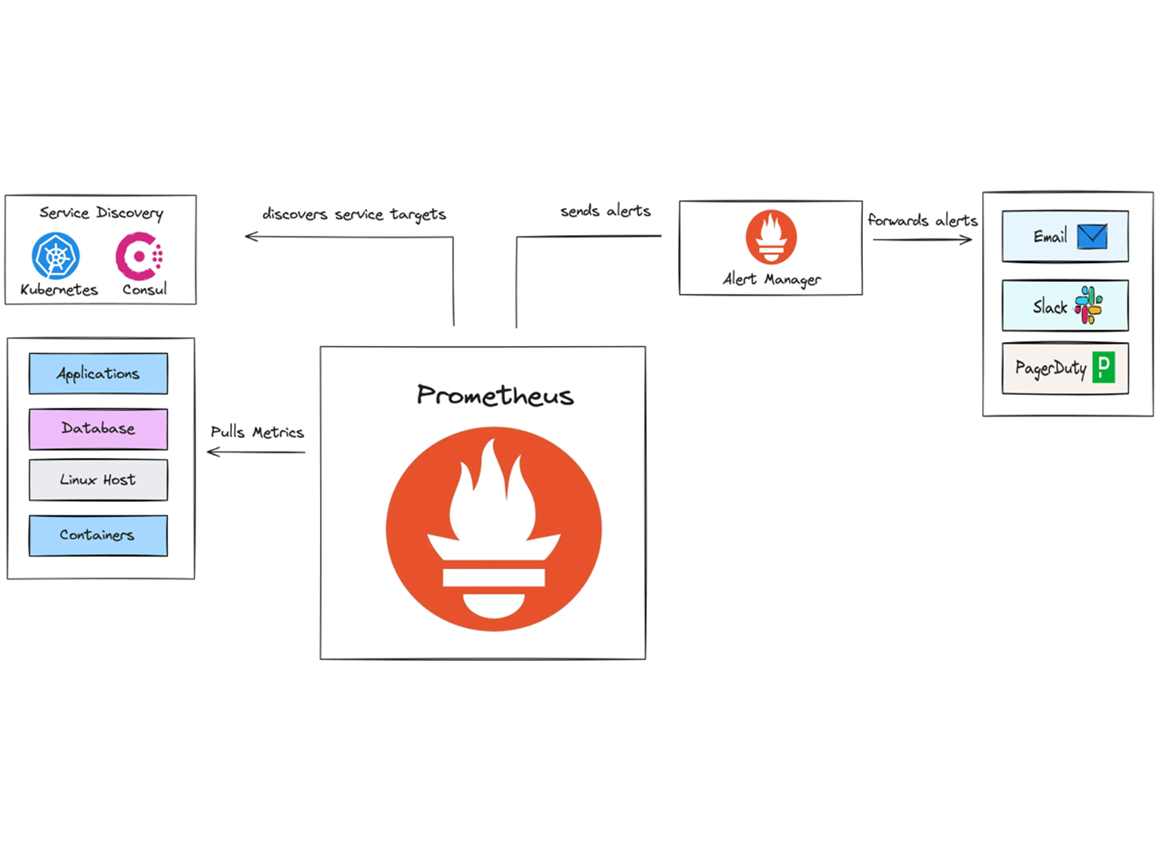
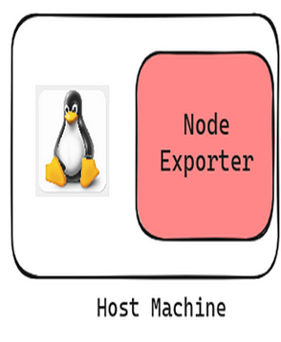
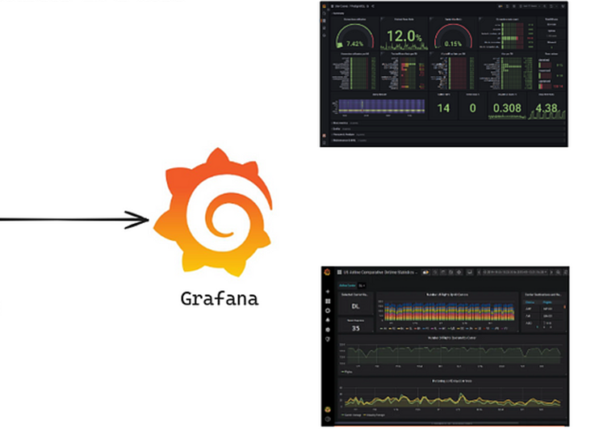

Slide 11
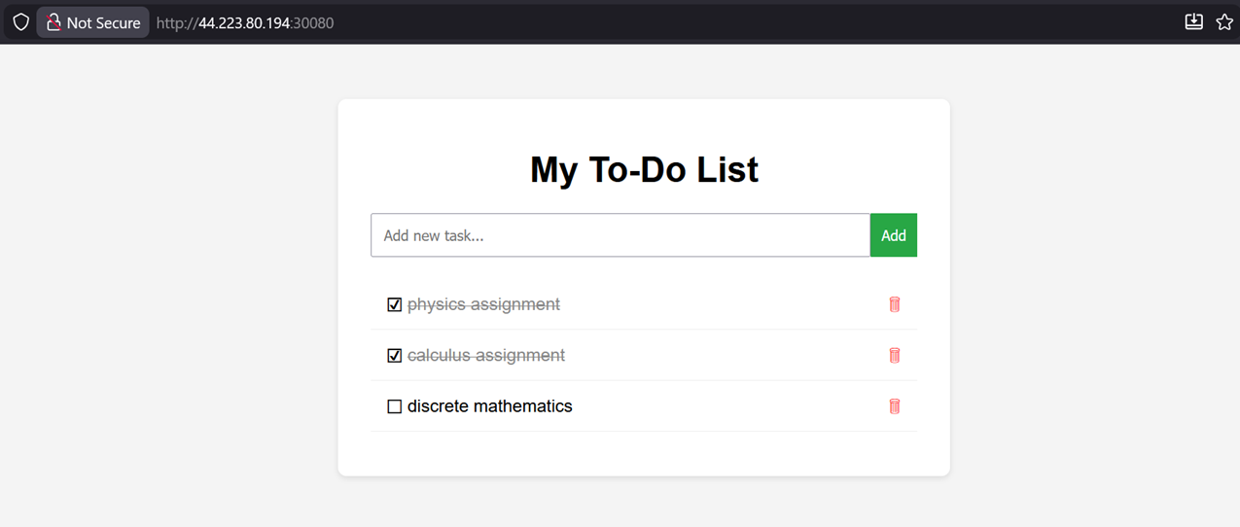
10/10

Slide 12
